Slide 1
Pronominal Anaphoric Resolution in Malayalam
Enfa Rose George , UG Scholar
Under the guidance of Mr.Mathews Abraham, Assistant Professor
Rajagiri School Of Engineering and Technology

Slide 2

Natural Language Processing
Natural Language Processing is broadly defined as the automatic manipulation of natural language, like speech and text, by software.
Some of the major tasks in NLP are
Speech recognition
Natural language understanding
Natural language generation
Notes:
Source: https://en.wikipedia.org/wiki/Coreference#Coreference_resolution

Slide 3
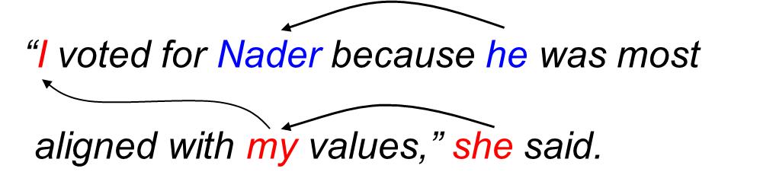
Coreference Resolution
Coreference resolution is the task of finding all expressions that refer to the same entity in a text.
Notes:
Source: https://en.wikipedia.org/wiki/Coreference#Coreference_resolution

Slide 4
Types Of Coreference
Anaphora
The music_{i} was so loud that it_{i} couldn't be enjoyed. –The anaphor it follows the expression to which it refers (its antecedent).
Cataphora
If they_{i} are angry about the music, the neighbors_{i} will call the cops. – The cataphor they precedes the expression to which it refers (its postcedent).
Split antecedents
Carol_{i} told Bob_{i} to attend the party. They_{i} arrived together. – The anaphor they has a split antecedent, referring to both Carol and Bob.
Coreferring noun phrases
The project leader_{i} is refusing to help. The jerk_{i} thinks only of himself. – Coreferring noun phrases, whereby the second noun phrase is a predication over the first.

Slide 5

Scope & Application
CR is the ultimate test for human like AI. CR systems is the basis for Winograd Schema Challenge, the test for AI systems that beat the Turing test.
This is because it requires Knowledge and commonsense reasoning to solve them.
The choices of "feared" and "advocated" turn the schema into its two instances:
The city councilmen refused the demonstrators a permit
because they feared violence.
The city councilmen refused the demonstrators a permit
because they advocated violence.

Slide 6
Scope & Application
Critical for improvement of tasks like
Abstract Document summarization
Question answering
Information extraction.

Slide 7
The Objective Of the Paper
വിനോദസഞ്ചാരികൾ അതിരാവിലെ ഗുരുവായൂർ ക്ഷേത്രത്തിൽ പ്രവേശിച്ച് ആരാധന നടത്തി.
വൈകുന്നേരം അവർ വീണ്ടും അവിടെ പോവുകയും
ദൈവത്തെ ആരാധിക്കുകയും ചെയ്തു

Slide 8
The Method
How do we approach the problem?

Slide 9

General Idea
Algorithms intended to resolve references commonly look first for the nearest preceding individual that is compatible with the referring expression (Hobbs Algorithm)
The literature in Malayalam on the topic uses inhouse data sets to built parsers and taggers.
There are a lot of handwritten rules, and are noticed to be heavy.

Slide 10
Design and Implementation Constraints
Malayalam is a morphologically rich language which means we have more features to take into consideration
The performance of Parsers and Taggers publicly available is a direct bottleneck.
Resource - poor language

Slide 11
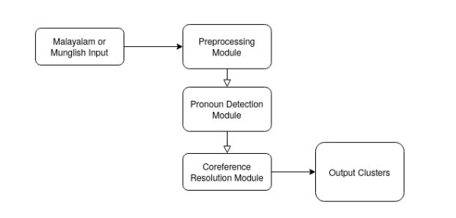
Basic Architecture

Slide 12
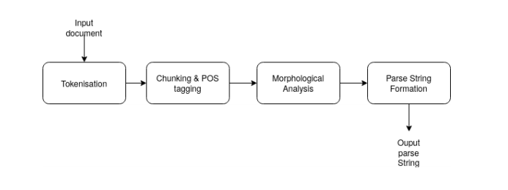
Preprocessing Module

Slide 13
Preprocessing Module
Tokenization ie splitting our document to sentences using polyglot library which uses Unicode Text Segmentation Algorithm.
['വിനോദസഞ്ചാരികൾ അതിരാവിലെ ഗുരുവായൂർ ക്ഷേത്രത്തിൽ പ്രവേശിച്ച് ആരാധന നടത്തി .', 'വൈകുന്നേരം അവർ വീണ്ടും അവിടെ പോവുകയും ദൈവത്തെ ആരാധിക്കുകയും ചെയ്തു .']

Slide 14
Preprocessing Module
Chunking ( Converting Sentences into phrases) & minimal Parts of Speech tagging using Devadath’s Shallow Parser.
Morphological Analysis done using HFST implementation mlmorph
We generate a knowledge parse string combining all of this info.
Notes:
Helsinki Finite-State Technology (HFST) is a computer programming library and set of utilities for natural language processing with finite-state automata and finite-state transducers. It is free and open-source software, released under a mix of the GNU General Public License version 3 (GPLv3) and the Apache License.

Slide 15
Preprocessing Module
[[['വിനോദസഞ്ചാരികൾ', 'N', 'ADJ', 'N', 'PL', 'N__NN', 'B-NP'], ['അതിരാവിലെ', 'ADJ', 'NP', 'N__NN', 'B-NP'], ['ഗുരുവായൂർ', 'NP', 'N__NN', 'B-NP'], ['ക്ഷേത്രത്തിൽ', 'N', 'LOCATIVE', 'N__NN', 'B-NP'], ['പ്രവേശിച്ച്', 'V__VM__VNF', 'B-VGNF'], ['ആരാധന', 'N', 'N__NN', 'B-NP'], ['നടത്തി', 'V__VM__VF', 'B-VGF'], ['.', 'RD__PUNC', 'B-BLK']], [['വൈകുന്നേരം', 'NP', 'N__NN', 'B-NP'], ['അവർ', 'PRN', 'PR__PRP', 'B-NP'], ['വീണ്ടും', 'RB', 'B-RBP'], ['അവിടെ', 'CNJ', 'PR__PRP', 'B-NP'], ['പോവുകയും', 'V__VM__VINF', 'B-VGINF'], ['ദൈവത്തെ', 'N', 'ACCUSATIVE', 'N__NN', 'B-NP'], ['ആരാധിക്കുകയും', 'V__VM__VINF', 'B-VGINF'], ['ചെയ്തു', 'V__VM__VF', 'B-VGF'], ['.', 'RD__PUNC', 'B-BLK']]]

Slide 16
Preprocessing Module- Sieve
Do some basic candidate invalidation/screening.
Verb Phrases cannot be a possible candidate.
[[['വിനോദസഞ്ചാരികൾ', 'N', 'ADJ', 'N', 'PL', 'N__NN', 'B-NP'], ['അതിരാവിലെ', 'ADJ', 'NP', 'N__NN', 'B-NP'], ['ഗുരുവായൂർ', 'NP', 'N__NN', 'B-NP'], ['ക്ഷേത്രത്തിൽ', 'N', 'LOCATIVE', 'N__NN', 'B-NP'], ['പ്രവേശിച്ച്', 'V__VM__VNF', 'B-VGNF'], ['ആരാധന', 'N', 'N__NN', 'B-NP'], ['നടത്തി', 'V__VM__VF', 'B-VGF'], ['.', 'RD__PUNC', 'B-BLK']], [['വൈകുന്നേരം', 'NP', 'N__NN', 'B-NP'], ['അവർ', 'PRN', 'PR__PRP', 'B-NP'], ['വീണ്ടും', 'RB', 'B-RBP'], ['അവിടെ', 'CNJ', 'PR__PRP', 'B-NP'], ['പോവുകയും', 'V__VM__VINF', 'B-VGINF'], ['ദൈവത്തെ', 'N', 'ACCUSATIVE', 'N__NN', 'B-NP'], ['ആരാധിക്കുകയും', 'V__VM__VINF', 'B-VGINF'], ['ചെയ്തു', 'V__VM__VF', 'B-VGF'], ['.', 'RD__PUNC', 'B-BLK']]]

Slide 17
Preprocessing Module - Sieve
['( S ( CHUNK ( N ( NN ( N ( ADJ ( N ( PL വിനോദസഞ്ചാരികൾ ) ) ) ) ) ) ) ( CHUNK ( N ( NN ( ADJ ( NP അതിരാവിലെ ) ) ) ) ) ( CHUNK ( N ( NN ( NP ഗുരുവായൂർ ) ) ) ) ( CHUNK ( N ( NN ( N ( LOCATIVE ക്ഷേത്രത്തിൽ ) ) ) ) ) ( CHUNK ( N ( NN ( N ആരാധന ) ) ) ) ) ', '( S ( CHUNK ( N ( NN ( NP വൈകുന്നേരം ) ) ) ) ( CHUNK ( PR ( PRP ( PRN അവർ ) ) ) ) ( CHUNK ( PR ( PRP ( CNJ അവിടെ ) ) ) ) ( CHUNK ( N ( NN ( N ( ACCUSATIVE ദൈവത്തെ ) ) ) ) ) ) ']

Slide 18
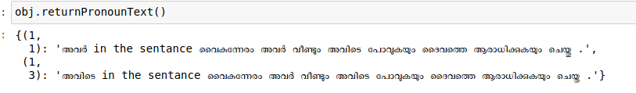
Pronoun Detection

Slide 19
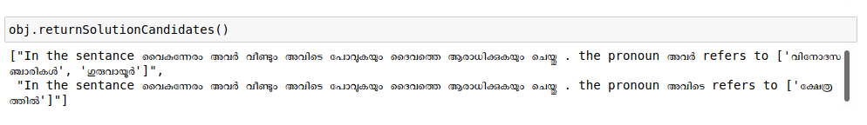
Naive CR Algorithm - slight variation of Hobbs
Do left to right depth first parsing sentence wise, looking for NP - Proper Nouns and then NN - Common Nouns candidates.

Slide 20

Results & Discussion

Slide 21

Result & Application
For simple sentence that is parsable by the underlying models, the naive algorithm performs well.
When tested on random 30 wikipedia documents, the algorithm performed with a 65% accuracy - which is a good marking for one of the first works in Malayalam.
The work can be applied to Malayalam chat applications. The small conversation style text would be perfect.
Question answering systems should work with well depending on the complexity of the documents we are extracting info from.

Slide 22
Discussion
The algorithm is not abstract summarisation ready.
The work’s accuracy goes to 65% in large documents due reasons including the following
The Chunking & Parsing and mlmorph algorithms though best in the use open source has low accuracy in real world uncurated corpus which is a direct bottleneck.
The mlmorph is able to analyse only 45% of the words in an uncurated real world corpus.

Slide 23
Discussion
Confusion of commonsense & context understanding . Depends on how you read it
പിണറായി വിജയനോട് പറഞ്ഞു
Did പിണറായി say to വിജയൻ
Or
did the person whose full name is പിണറായി വിജയൻ speak?

Slide 24
Comparison & BenchMarking
This is the first work in Anaphora Resolution in Malayalam with verifiable results using public taggers and tools.
The other works are made from private datasets and taggers. The tools are not available publicly nor can it be recreated. Hence Benchmarking is not possible.

Slide 25
Future Work
If the taggers which are bottlenecks to performance improves, the CR algorithm improves accordingly.
Learnings from this can be transferred to Entity Resolution algorithms in Malayalam.
If tagged corpus could be created, we can attempt machine learning methods or Deep Reinforcement learning like that in English which could improve performance.
Study how such tools are developed could open new avenues of building NLP tools to resource poor similarly rich languages and could accelerate development

Slide 26

Thank you
Open for Questions

Slide 27
References
Clark and Manning. 2016. Deep Reinforcement Learning for Mention-Ranking Coreference Models.
Clark and Manning. 2016. Improving Coreference Resolution by Learning Entity-Level Distributed Representations
Clark and Manning. 2015. Entity-Centric Coreference Resolution with Model Stacking.
Raghunathan, Lee, Rangarajan, Chambers, Surdeanu, Jurafsky, Manning. 2010. A Multi-Pass Sieve for Coreference Resolution EMNLP-2010,
Recasens, Can, and Jurafsky. 2013. Same Referent, Different Words: Unsupervised Mining of Opaque Coreferent Mentions.
Recasens, Marneffe, and Potts. 2013. The Life and Death of Discourse Entities: Identifying Singleton Mentions.
Lee, Recasens, Chang, Surdeanu, and Jurafsky. 2012. Joint Entity and Event Coreference Resolution across Documents.
Lee, Peirsman, Chang, Chambers, Surdeanu, Jurafsky.Stanford's Multi-Pass Sieve Coreference Resolution System at the CoNLL-2011 Shared Task.

Slide 28
References
http://www.lrec-conf.org/proceedings/lrec2016/topics.html
Pronominal Anaphora Resolution using Salience Score for Malayalam, Athira S, Lekshmi T S, Rajeev R R, Elizabeth Sherly and Reghuraj P C, 2014 [ IITMK, GE Palakad]
VASISTH-An Anaphora Resolution System, Sobha [M.G.University],L B.N.Patnaik[ Indian Institute of Technology], 2011
Anaphora resolution in Malayalam and Hindi, Sobha Lalithadevi, Anna University, 2010
A Generic Anaphora Resolution Engine for Indian Languages, Sobha Lalitha Devi, Vijay Sundar Ram,Pattabhi RK Rao, 2014
A Survey on Anaphora Resolution Toolkits, Seema Mahato, Ani Thomas , Neelam Sahu
Referential Entity Resolution in a Corpus of Malayalam, Dr.S.Rajendran,Tamil University

